Slide 1
Flow Chart
Welcome Page
Instructions
Click Play
Win
Lose
Round 1
Win
Lose
Round 2
Win
Lose
Round 3
Win
Lose
Winner Page

Slide 2

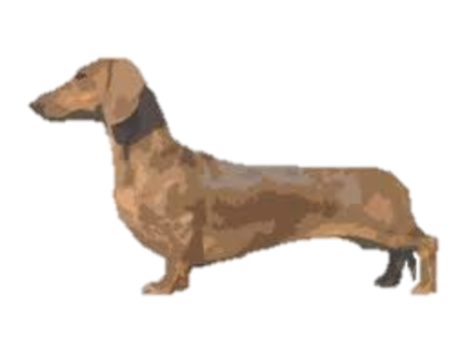

Wireframe
Kitty Graphic
Kitty Graphic
Kitty Graphic
Kitty Graphic
Kitty Graphic
Kitty Graphic
Kitty Graphic
Kitty Graphic
Kitty Graphic
Kitty Graphic
Kitty Graphic
Kitty Graphic
Kitty Graphic
Kitty Graphic
Kitty Graphic
Kitty Graphic
Kitty Graphic
Kitty Graphic
Kitty Graphic
Kitty Graphic
480px
Kitties move down every x seconds
Don’t let the kitties reach the fence!
720px

